Slide 1
CIS CONTROL 19: INCIDENT RESPONSE & MANAGEMENT-II
INCIDENT RESPONSE & MANAGEMENT

Slide 2
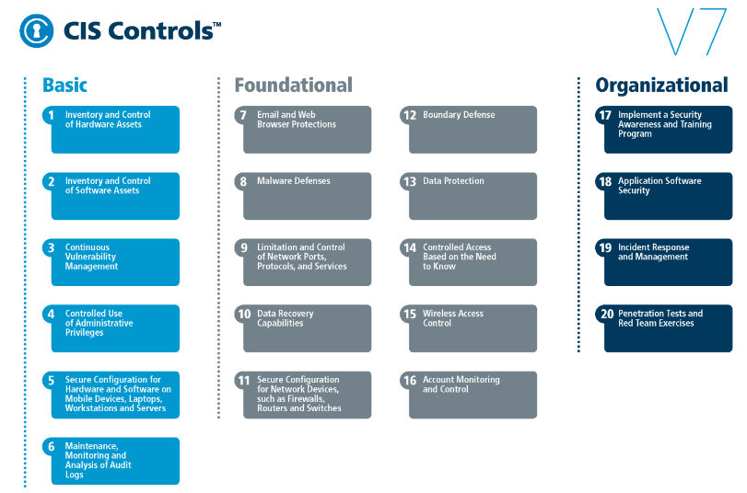
CIS CONTROL 19: INCIDENT RESPONSE & MANAGEMENT-II
https://www.cisecurity.org/controls/

Slide 3
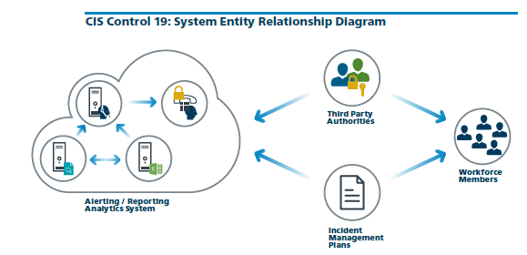
CIS CONTROL 19: INCIDENT RESPONSE & MANAGEMENT-II
https://www.cisecurity.org/controls/

Slide 4
CIS CONTROL 19: INCIDENT RESPONSE & MANAGEMENT-II
19.5: Maintain Contact Information For Reporting Security Incidents
Assemble & maintain information on third-party contact information to be used to report a security incident, such as Law Enforcement, relevant govt departments, vendors, etc

Slide 5
CIS CONTROL 19: INCIDENT RESPONSE & MANAGEMENT-II
19.6: Publish Information Regarding Reporting Computer Anomalies and Incidents
Publish information for all workforce members, regarding reporting computer anomalies and incidents to the incident handling team. Such information should be…

Slide 6
CIS CONTROL 19: INCIDENT RESPONSE & MANAGEMENT-II
19.6: Publish Information Regarding Reporting Computer Anomalies and Incidents
…included in routine employee awareness activities.

Slide 7
CIS CONTROL 19: INCIDENT RESPONSE & MANAGEMENT-II
19.7: Conduct Periodic Incident Scenario Sessions for Personnel
Plan and conduct routine incident response exercises and scenarios for the workforce involved in the incident response to maintain awareness and comfort in responding to real world threats.

Slide 8
CIS CONTROL 19: INCIDENT RESPONSE & MANAGEMENT-II
19.7: Conduct Periodic Incident Scenario Sessions for Personnel
…Exercises should test communication channels, decision making, and incident responders technical capabilities using tools and data available to them.

Slide 9
CIS CONTROL 19: INCIDENT RESPONSE & MANAGEMENT-II
19.8: Create Incident Scoring and Prioritization Schema
Create incident scoring and prioritization schema based on known or potential impact to your organization. Utilize score to define frequency of status updates and escalation procedures.

